Slide 1
CONSTITUTION DAY 2026
the constitution belongs to you!
Presented by:
Name
Title
Notes:
40 min total

Slide 2
Hello, my name is (insert name)
[INSERT JOB TITLE]
I help people by [INSERT DESCRIPTION]
A fun fact about me [INSERT RESPONSE]
Notes:
Welcome & who you are | ~ 3 min
Goal: set a warm, curious vibe. Students who feel comfortable will participate more — and that's what makes the visit memorable. Be a real person before you’re a lawyer.
Introduce yourself by first name, where you’re from, and what you do in plain words (“I’m a lawyer” — or judge, paralegal, and so on).
Give a 2–3 sentence bio in kid terms: what kind of law you do, what a normal day looks like, one thing you like about it.
Say why you’re there today: you pledged, along with hundreds of legal professionals across Washington, to connect with and visit a classroom around Constitution Day.
K–5: keep the bio concrete — “I help people who are having a disagreement figure it out fairly.” Skip the jargon.
Tip: ask the teacher to introduce you briefly first. It gives you a soft landing and a little authority in the room.

Slide 3
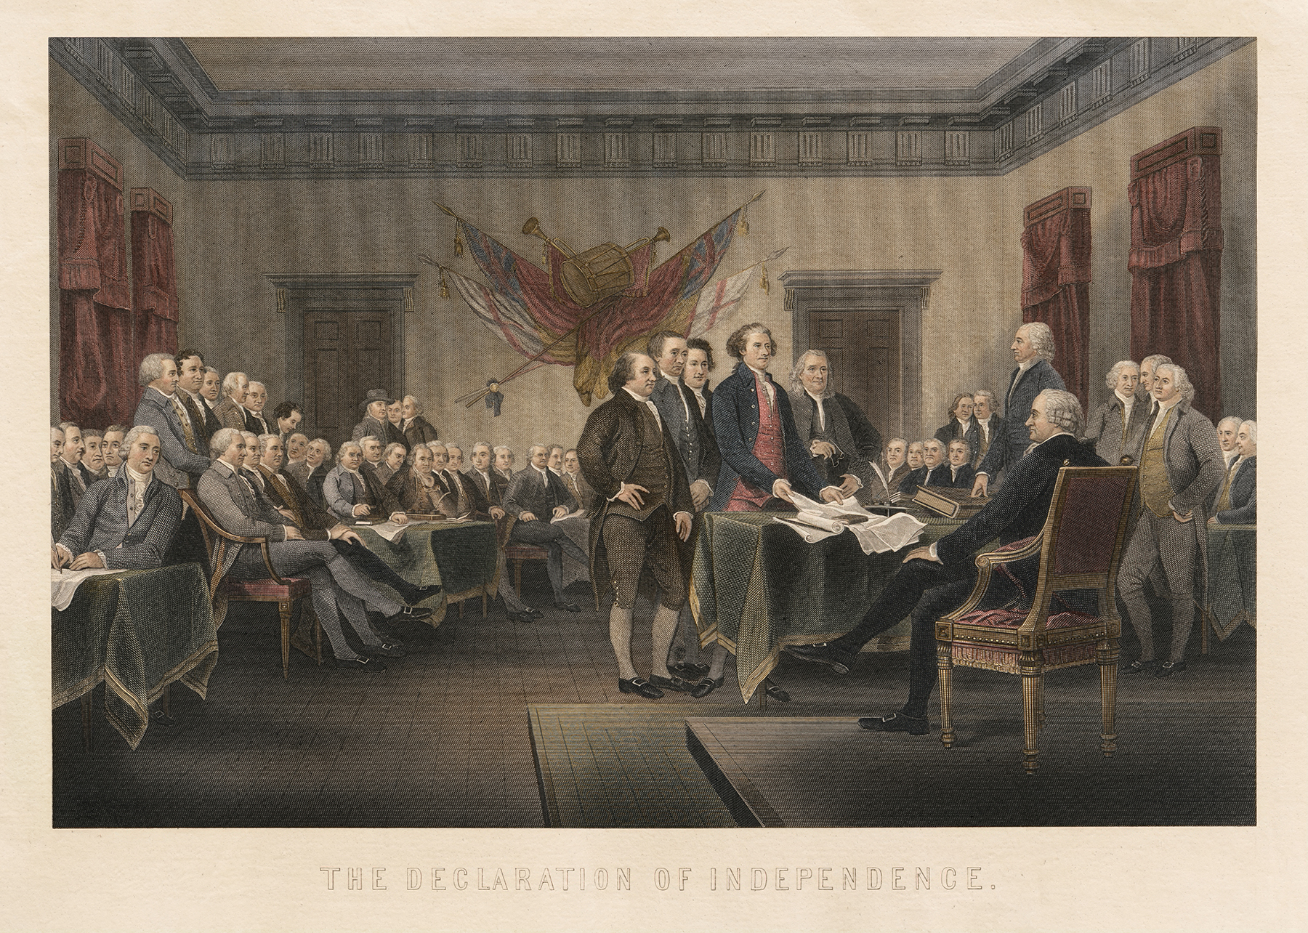
Why am I here?
The U.S. Constitution was signed on September 17, 1787.
Notes:
Why this year, why the Constitution? | ~ 3 min
Goal: set the stakes and introduce the core ideas you chose.
Name the moment: 2026 marks the 250th anniversary of the Declaration of Independence (1776). The country is having a big birthday — and the next 250 years belong to them.
Explain the Constitution simply: it’s the country’s founding document — a set of promises about fairness, rights, and how we make decisions together. It belongs to everyone, including them.
This is where your core ideas land. Work in the two principles you chose, in plain language.
Add one honest beat: it’s a work in progress. The promise hasn’t always matched reality, and each generation works to close that gap. That’s the invitation to them.
K–5: “promises our country made to everyone who lives here.” Try the rulebook metaphor — a game with no rules isn’t fun or fair.
Tip: don’t lecture the history. Two or three sentences of framing, then make it about them. A throughline that works at every grade: “The next 250 years are yours to lead.”

Slide 4
Some quick reminders…
✓ Listen to understand.
✓ Speak respectfully.
✓ Take turns.
✓ Be curious.
✓ Support our ideas with reasons.
✓ Respect different viewpoints.
✓ Help everyone feel included.
Together, we'll practice the same skills that help democracy work!
Notes:
Set expectations | ~1 min
Briefly set expectations for class discussions.

Slide 5
Today we will…
LEARN
what the U.S. Constitution is
DISCUSS
fairness and rules
EXPLORE
how lawyers help people
Notes:
Key takeaways for students, slides 5-6 | ~ 2 min
Goal: set up what the students should watch for ahead of the activity. These takeaways pair with the core ideas you chose: the principles are what the Constitution is; the takeaways are why it matters to them. Make it personal and portable - they should leave holding onto a couple of ideas.

Slide 6
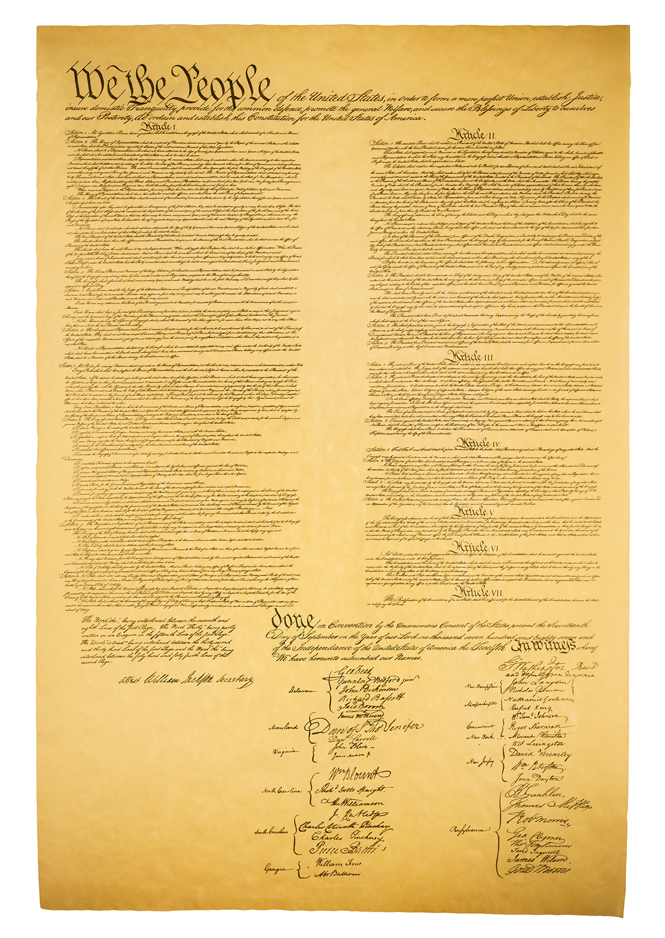
Today’s BIG ideas!
Equality + Fairness
The Rule of Law
The Constitution Can Change
Protecting the Constitution
Notes:
Key takeaways for students, cont’d
Before you start: write these takeaways on the board. It signals to students that the visit has structure, and they're expected to track it — and it gives you a natural anchor to return to during the debrief.

Slide 7
TODAY’S BIG IDEAS
WHAT IS THE CONSTITUTION?
Notes:
The main event: slides 7-22 | ~20 min

Slide 8
Recess without rules?!
CORE QUESTIONS:
What would happen?
Would everyone have fun?
Would it be fair?
What can we do to keep recess safe and fair for everyone?
Notes:
The main event, cont’d
Let students generate answers but lead them towards a discussion re. why rules are an important part of helping us all live together peacefully in community.
Transition: "Rules help people play fairly.”

Slide 9
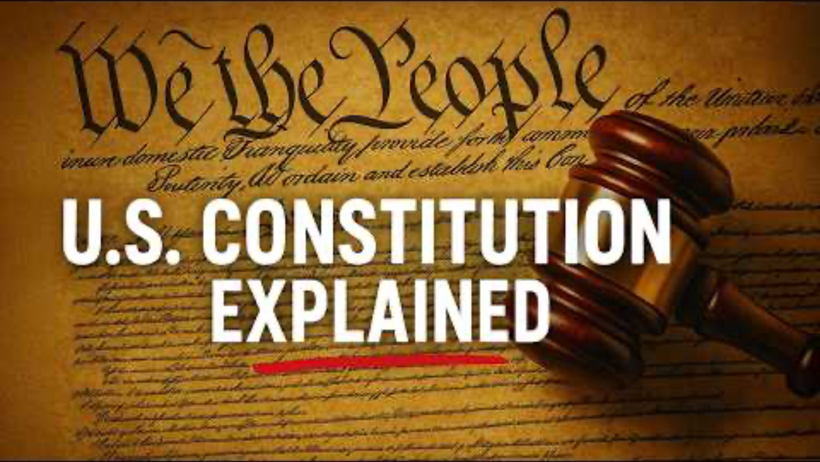
What is the Constitution?
A rulebook for our country!
WATCH > This YouTube video created by Quizlet and view more learning content from the group at www.youtube.com/@quizlet
Notes:
The main event, cont’d
The Constitution is like a rulebook for our country.

Slide 10
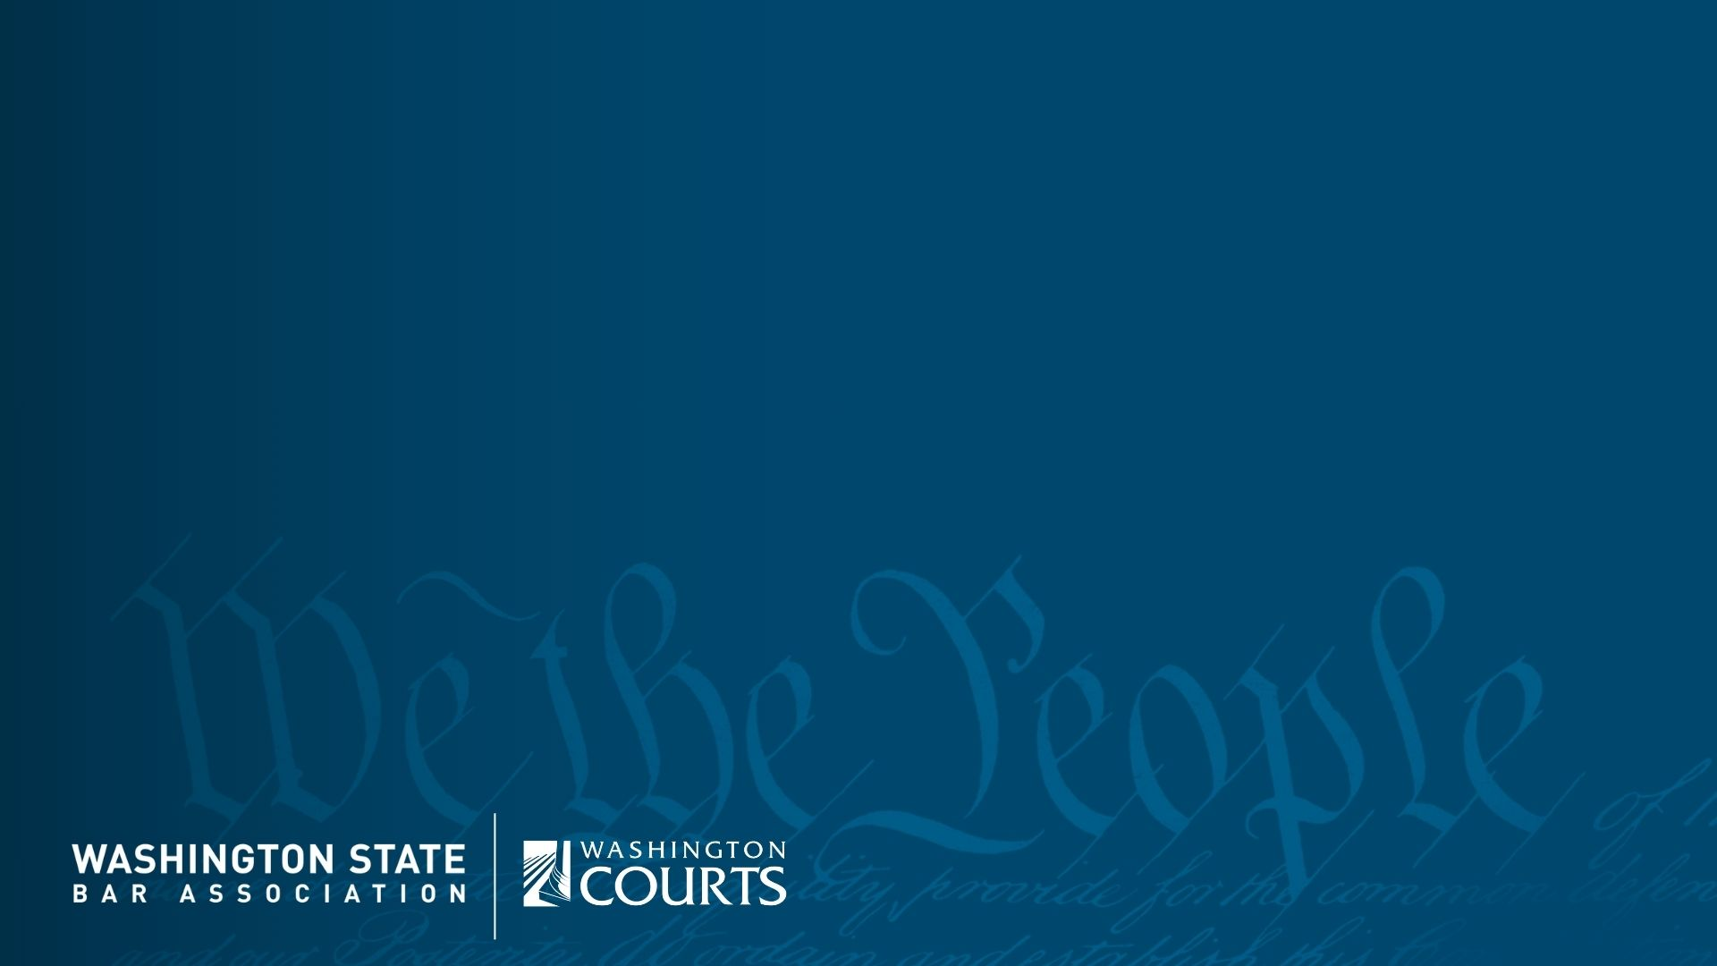
Notes:
The main event, cont’d
Introduce this video as a short overview of the Constitution. Play video directly from slide. Video credit to: https://www.youtube.com/watch?v=9C3xhHN_LQ4

Slide 11
TODAY’S BIG IDEAS
THE CONSTITUTION:
FAIRNESS AND RULES
Notes:
The main event, cont’d
Core Constitutional idea: Equality and fairness - Everyone is treated equally under the law - a promise the country is still working to keep.

Slide 12
The same punishment?
Two students break the same classroom rule. One gets a warning; the other loses recess for three days. The teacher does not explain why.
QUESTIONS TO CONSIDER:
Is it fair for consequences to be different?
What information might matter?
Notes:
The main event, cont’d
Equal treatment means decisions should have fair reasons—not favoritism or bias.

Slide 13
TODAY’S BIG IDEAS
THE CONSTITUTION: THE RULE OF LAW
Notes:
The main event, cont’d
Core Constitutional idea: The rule of law - No one is above the law - not even the government. The same rules apply to everyone.

Slide 14
Fair rules for everyone?
A student brings a board game to school to play with a group of friends after school. Before they begin, everyone agrees: each player gets one turn and rolls the dice once. Halfway through the game, the student who brought the game is losing and says, “Since this is my game board, I have decided that I get to roll twice on each of my turns.”
Notes:
The main event, cont’d
A rule is not fair just because it exists. People need to know it, understand it, and see that it applies to everyone—including people in charge.

Slide 15
Fair rules for everyone?
QUESTIONS TO CONSIDER:
Is that fair?
Does owning the game mean that student should get different rules?
If the group wants to change a rule, what would be a fair way to do it?
Notes:
The main event, cont’d
A rule is not fair just because it exists. People need to know it, understand it, and see that it applies to everyone—including people in charge.

Slide 16
The Constitution can change
The people who wrote it knew the country would change.
They created a way to add new amendments (changes).
The Constitution has been amended 27 times.
Some amendments expanded rights and opportunities for more people.
Every generation helps shape America’s future.
Notes:
The main event, cont’d
Core Constitutional idea: (briefly touching upon) Civic agency* - The Constitution was designed to change - 27 amendments make it a living framework every generation shapes.
*For younger learners, focus on the meaning behind “civic agency” rather than the term itself. Simple ideas—like speaking up, helping your community, and making a difference—will be more meaningful and accessible.
When the Constitution was written almost 250 years ago, the people who wrote it knew they wouldn't have all the answers forever.
They understood that the country would grow, change, and face new challenges.
So, they created a way to make changes to the Constitution when the American people decided something needed to be improved.
That's why we sometimes call the Constitution a 'living document.' Not because the words change every day, but because people continue to learn from it, interpret it, and improve it.
For example, amendments were added to end slavery, give women the right to vote, and lower the voting age to 18.
The Constitution has been amended 27 times. (Or more simply put, "the rulebook has been updated many times.) That means it wasn't meant to be perfect on day one—it was meant to grow with the country.

Slide 17
Protecting the Constitution
Treating people fairly
Listening to different viewpoints
Speaking up respectfully
Solving disagreements peacefully
Helping our community
Learning about our rights
Voting when we are 18
Which one could you do today?
Notes:
The main event, cont’d
Core Constitutional idea: (briefly touching upon) We the People - Government's power comes from the people - students have a voice through voting, juries, and speaking up.
Sometimes people think protecting the Constitution is something only judges, lawyers, or elected leaders do. But the truth is, protecting democracy starts with ordinary people. You can practice many of these skills right now. When you listen to someone else's ideas, even when you disagree, you're helping democracy work. When you speak up respectfully about something that seems unfair, you're helping democracy work. When you follow rules that are fair and help improve rules that aren't working, you're helping democracy work. When you treat people with respect and kindness, you're helping democracy work. One day, many of you will vote, serve on juries, volunteer in your communities, or maybe even become lawyers, judges, teachers, or leaders. Those are all ways people help protect our system of government. The Constitution begins with the words 'We the People.' That means protecting it isn't someone else's job. It belongs to all of us.
Discussion Questions:
• Which of these things can you do today?
• Which one do you think is most important?
• Can you think of a time when you helped solve a disagreement fairly?
• Can you think of any other things you can do to help protect the Constitution?

Slide 18
The Constitution belongs to you!
The United States of America is turning 250 years old this year.
The next 250 years belong to you!
Notes:
The main event, cont’d
Core Constitutional idea: (briefly touching upon) We the People - Government's power comes from the people - students have a voice through voting, juries, and speaking up.

Slide 19
TODAY’S BIG IDEAS
HOW LAWYERS HELP
MAKE THE CONSTITUTION’S PROMISES REAL
Notes:
The main event, cont’d

Slide 20
Lawyers and the Constitution
Constitution
Rights
Lawyers
People
Lawyers play a role in helping our system work fairly.
Notes:
The main event, cont’d
Walk through the diagram from left to right:
The Constitution: “The Constitution contains important promises about how our government works and about rights and fairness.”
Rights: “Those promises include rights and freedoms that affect real people—like freedom of speech and the right to be treated equally under the law.”
People: “But having a right written down doesn’t always mean it’s easy to understand or protect. People may disagree about what a rule means or whether someone has been treated fairly.”
Lawyers: “That’s where lawyers can help. Lawyers help people understand their rights, navigate the rules, solve disagreements, and speak up when something isn’t working the way it should.”
Bring it back to the big idea: “Lawyers help people understand and protect the rights the Constitution promises.”
Optional question for students: “Can you think of a situation where someone might need a lawyer to help them understand a rule or protect a right?”

Slide 21
What lawyers do
Constitution
Rights
Lawyers
People
Understand their rights
Solve problems fairly
Make sure rules are followed
Stand up for people when something isn't right
Help keep the promises in the Constitution real
Notes:
The main event, cont’d
Some lawyers help families. Some help businesses. Some help people who have been harmed. Some work for the government. Some become judges.
Even though lawyers do many different jobs, they all play a role in helping our system work fairly.

Slide 22
So many ways to work in Law
⚖️ Lawyer
Helps people solve legal problems
👩‍⚖️ Judge
Listens and makes decisions in court
📝 Paralegal
Help lawyers prepare and organize cases
🤝 Mediator
Helps people work out disagreements
🎤 Court Reporter
Creates a record of what happens to court
🔍 Investigator
Helps people solve legal problems
You don't have to be a lawyer to help our justice system work!
Notes:
The main event, cont’d
Name the range: lawyers, judges, paralegals, legal aides, clerks — lots of ways to work in and around the law. You don't have to be a lawyer to be part of justice.

Slide 23
… AND FINALLY
WHAT DO I DO?
Notes:
Personal connection | ~3 min
Talk a little more about what you do and how that helps support our Constitution and the Rule of Law.
Ideas:
How my work connects to fairness/rules...
A moment when I helped someone...

Slide 24
QUESTIONS?
Notes:
Wrap-up + Q&A | ~7 min
Allow the remaining time for discussion and Q&A.

Slide 25
Your visit at a glance
OBJECTIVES
Ready-to-run, discussion-based, and designed for a first classroom visit. Using familiar examples, two kid-friendly fairness scenarios, a short video, and guided conversation, students explore how the Constitution supports fair rules and equal treatment, how they can help democracy work, and how lawyers help make the Constitution’s promises real.

Slide 26
Your visit at a glance
OBJECTIVES
Students will explain why fair rules should have good reasons and apply to everyone. (The rule of law, Equality and fairness)
Students will recognize that the Constitution provides a framework for fairness, rights, and how our government works—and that it can change as our country grows. (Rights and liberties, Civic agency)
Students will identify ways they can help uphold constitutional principles through fairness, respectful discussion, civic participation, and community involvement. (We the People, Civic agency)

Slide 27
Your visit at a glance
STUDENT TAKEAWAYS — WHAT THEY LEAVE HOLDING
The Constitution belongs to all of us.
Fair rules should have good reasons and apply to everyone.
You can help democracy work—even before you are old enough to vote.
Lawyers help make the Constitution’s promises real in everyday life.

Slide 28
Your visit at a glance
Your visit at a glance
BEFORE YOUR VISIT
Personalize the introduction and “What Do I Do?” slides.
Confirm the visit length and classroom technology with the teacher.
Test the video and keep the video link open as a backup.
Review the speaker notes and choose the discussion questions you most want to ask.

